Slide 1
NEAT vs DEAP

Slide 2
Copy Task
In the copy task the network has to store and recall a long sequence of random binary vectors. The network is given a single bit to indicate the start of the exercise, a sequence of random bit vectors, and a delimiter bit to signal the beginning of the recall phase. The sequence is of 8-bit length.
Copy Task has been tested with both NEAT and DEAP with the following parameters.
NEAT (population size: 400 and 500 generations).
DEAP (population size: 100 *4 trees and 250 generations).

Slide 3
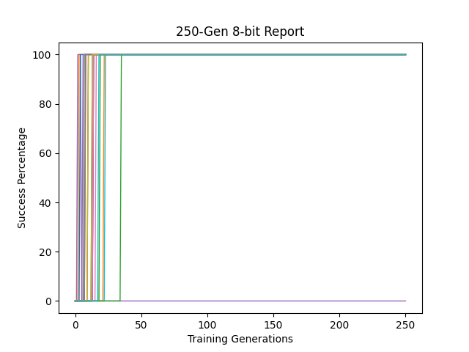
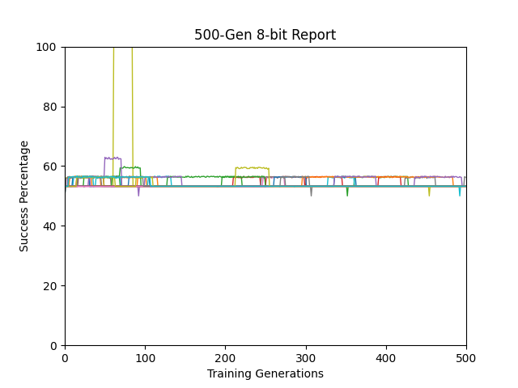
DEAP Results (20 run)
NEAT Results (20 run)
Results generated from testing champion of every generation against new set of data (50 example) that has never been seen before
Results generated from training fitness of every generation champion

Slide 4
Sequence recall
In this experiment the network is given a series of instructions marked with bits and then a random countdown would start, when the countdown reaches zero, the network would have to execute one of the instructions in the same order it was given.
We have different depths (instructions) for this experiment and random countdowns within the same sequence.
We’ll show results from 4, 5, 6, 15 and 21 deep tests.
NEAT was given an edge in this experiment (500 generation, 400 population) over DEAP (250 generation, 400 population)

Slide 5
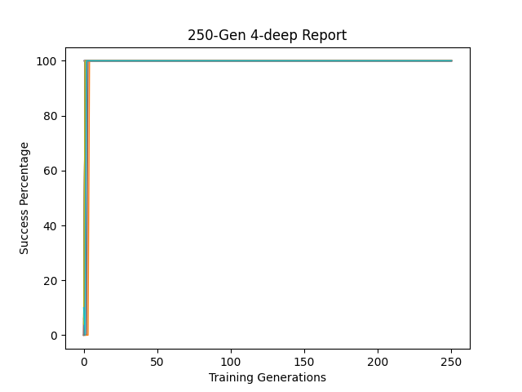
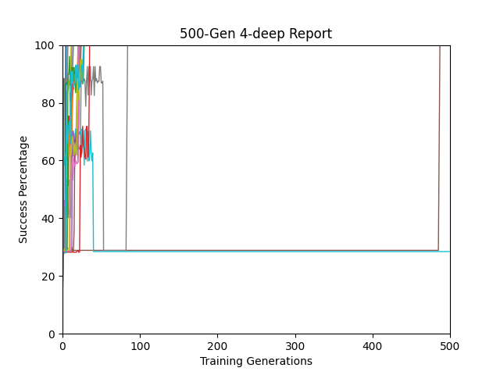
DEAP Results (20 run)
NEAT Results (20 run)
Results generated from testing champion of every generation against new set of data (50 example) that has never been seen before
Results generated from training fitness of every generation champion

Slide 6
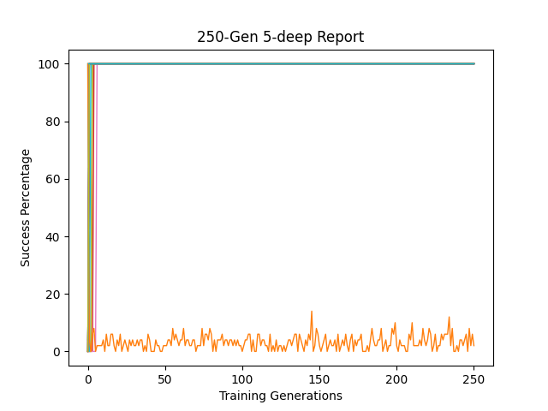
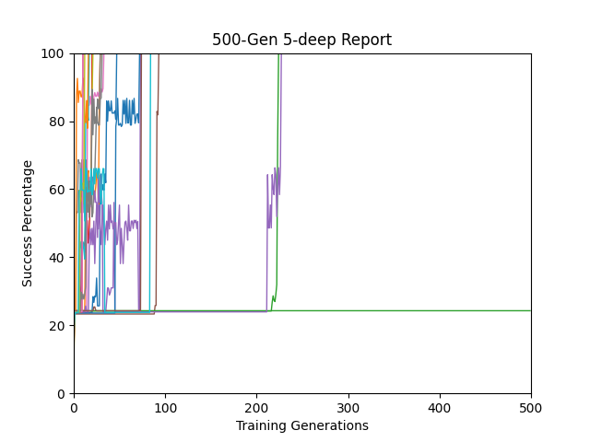
DEAP Results (20 run)
NEAT Results (20 run)
Results generated from testing champion of every generation against new set of data (50 example) that has never been seen before
Results generated from training fitness of every generation champion

Slide 7
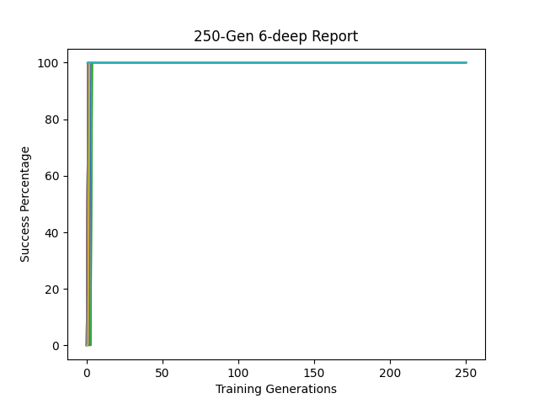
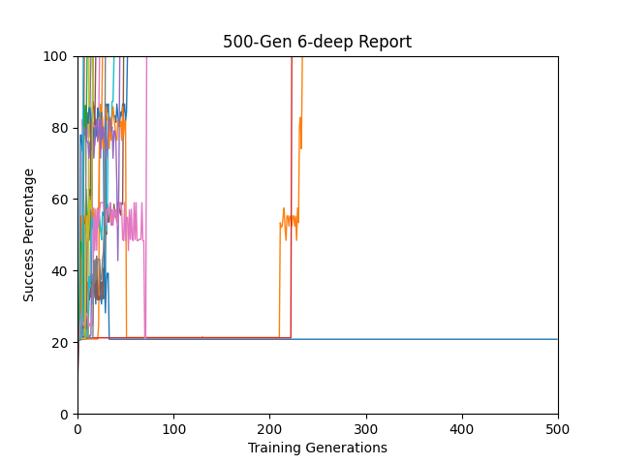
DEAP Results (20 run)
NEAT Results (20 run)
Results generated from testing champion of every generation against new set of data (50 example) that has never been seen before
Results generated from training fitness of every generation champion

Slide 8
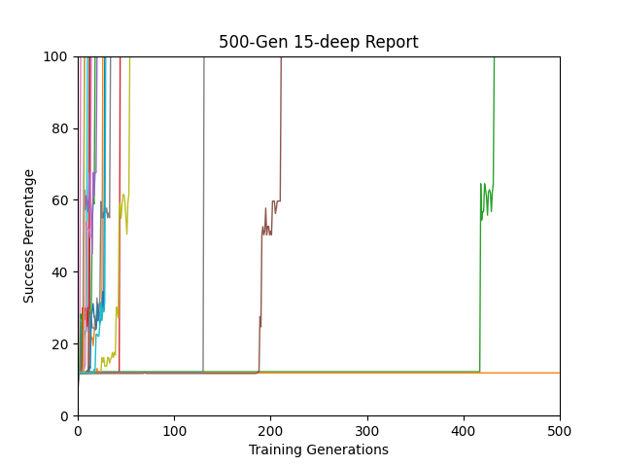
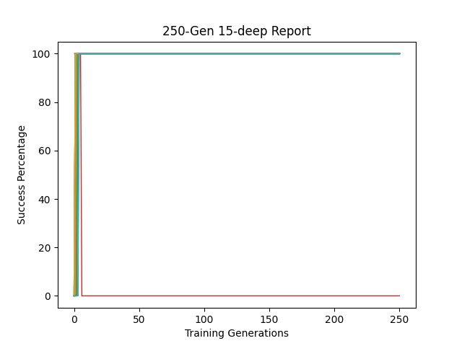
DEAP Results (20 run)
NEAT Results (20 run)
Results generated from testing champion of every generation against new set of data (50 example) that has never been seen before
Results generated from training fitness of every generation champion

Slide 9
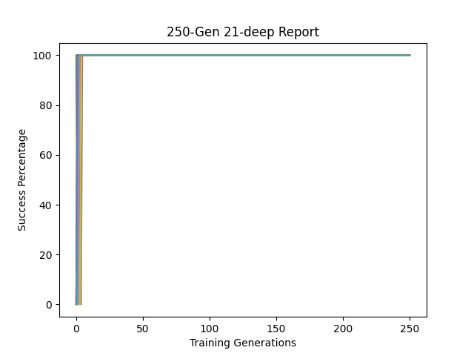
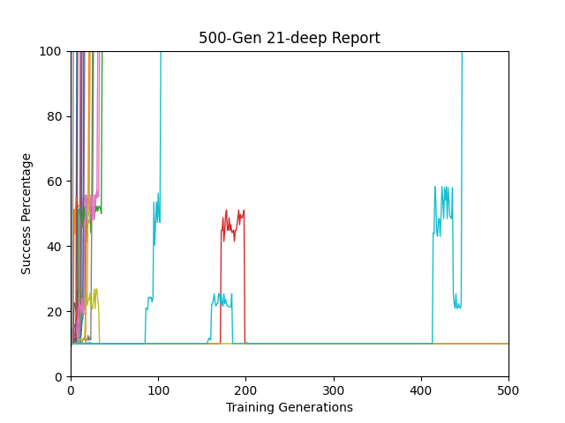
DEAP Results (20 run)
NEAT Results (20 run)
Results generated from testing champion of every generation against new set of data (50 example) that has never been seen before
Results generated from training fitness of every generation champion

Slide 10
Sequence classification
In this experiment we give the network a sequence of numbers (1 and -1) with a random number of noise in between (zeros), at the end of the sequence the network should be able to determine if the total is positive or negative.
We have different depths (instructions) for this experiment and random number of noise within the same sequence.
We’ll show results from 4, 5, 6, 15 and 21 deep tests.
NEAT was given an edge in this experiment (500 generation, 400 population) over DEAP (250 generation, 400 population)

Slide 11
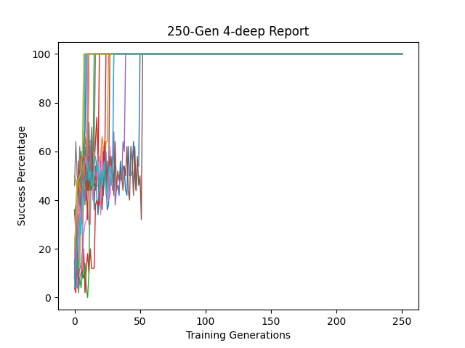
DEAP Results (20 run)
NEAT Results (20 run)
Results generated from testing champion of every generation against new set of data (50 example) that has never been seen before
Results generated from training fitness of every generation champion

Slide 12
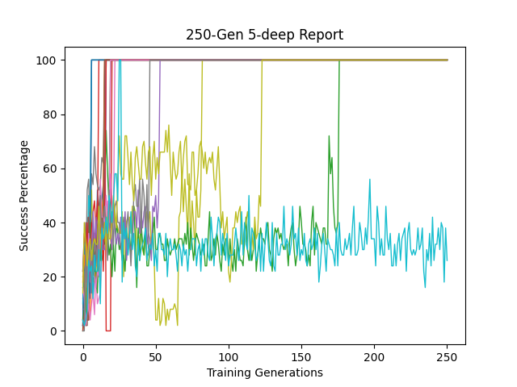
DEAP Results (20 run)
NEAT Results (20 run)
Results generated from testing champion of every generation against new set of data (50 example) that has never been seen before
Results generated from training fitness of every generation champion

Slide 13
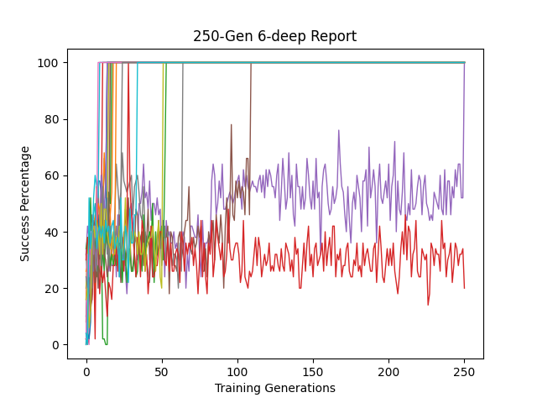
DEAP Results (20 run)
NEAT Results (20 run)
Results generated from testing champion of every generation against new set of data (50 example) that has never been seen before
Results generated from training fitness of every generation champion

Slide 14
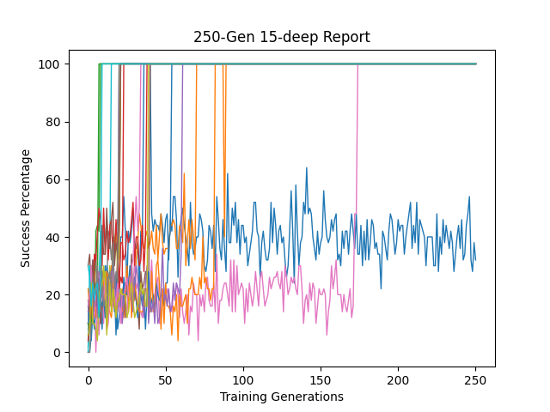
DEAP Results (20 run)
NEAT Results (20 run)
Results generated from testing champion of every generation against new set of data (50 example) that has never been seen before
Results generated from training fitness of every generation champion

Slide 15
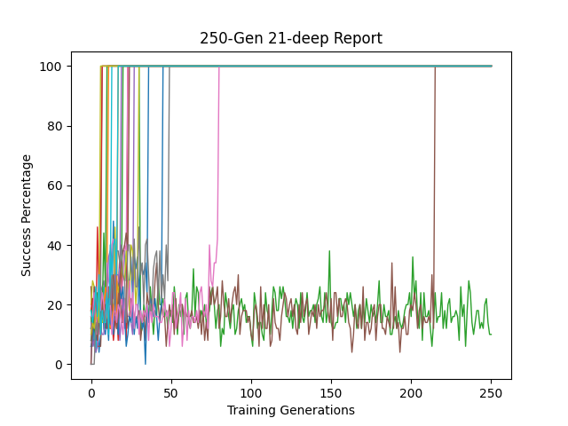
DEAP Results (20 run)
NEAT Results (20 run)
Results generated from testing champion of every generation against new set of data (50 example) that has never been seen before
Results generated from training fitness of every generation champion

Slide 16
NEAT vs Neat
(Arithmetic operators)
(Logical operators)

Slide 17
Copy Task
In the standard approach the network used arithmetic operators (add, subtract, protected division).
We added to those operators some logical ones to study the effect that will have on the network.
Logical operators added are:
And, or, not
Less than, Equal, If_then_else
Random number generator
True, false
multiplication

Slide 18
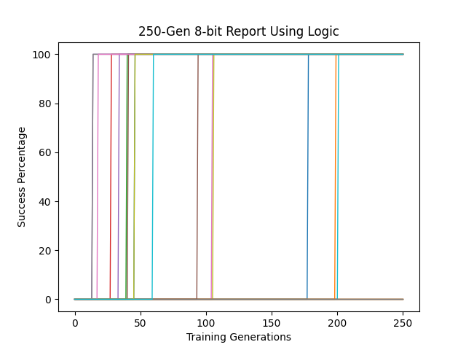
DEAP Results (20 run)
DEAP Results (20 run)
Using Arithmetic operators
With added logical operators

Slide 19
Sequence Recall
In the standard approach the network used arithmetic operators (add, subtract, protected division).
We added to those operators some logical ones to study the effect that will have on the network.
Logical operators added are:
And, or, not
Less than, Equal, If_then_else
Random number generator
True, false
multiplication

Slide 20
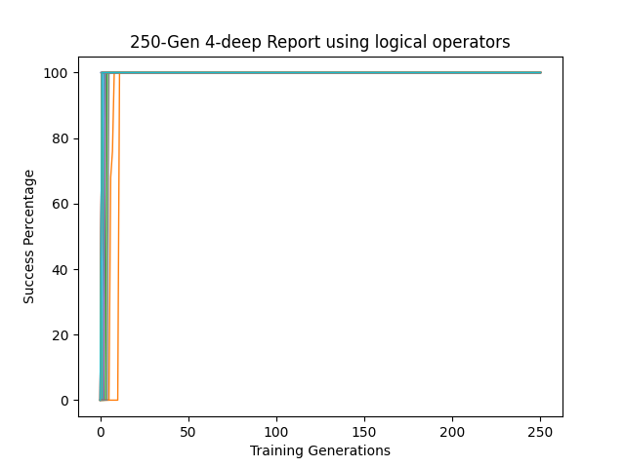
DEAP Results (20 run)
DEAP Results (20 run)
Using Arithmetic operators
With added logical operators

